Slide 1
COMPUTATIONAL MODELING FORUM
WEEK 3 (02/27/24)
Srihas Surapaneni | Sai Yadavalli | Dr. Browning

Slide 2
AGENDA
In today’s session we will explore matplotlib and going over last week’s problem.
01
02
03
04
Python Warm Up Exercise
Intro to MatPlotLib
Usage
Practice

Slide 3

02/27/2024 Attendance

Slide 4




PYTHON WARM UP
Create a function that, when given a non-empty string and an int (n), returns a new string where the char at index n has been removed. The value of n will be a valid index of a char in the original string (i.e. n will be in the range 0 … len(str) - 1 inclusive).
Example Returns:
missingChar('kitten', 0) → 'itten'
missingChar('kitten', 4) → 'kittn'
CHECK YOUR WORK AT: tinyurl.com/W3NO1

Slide 5
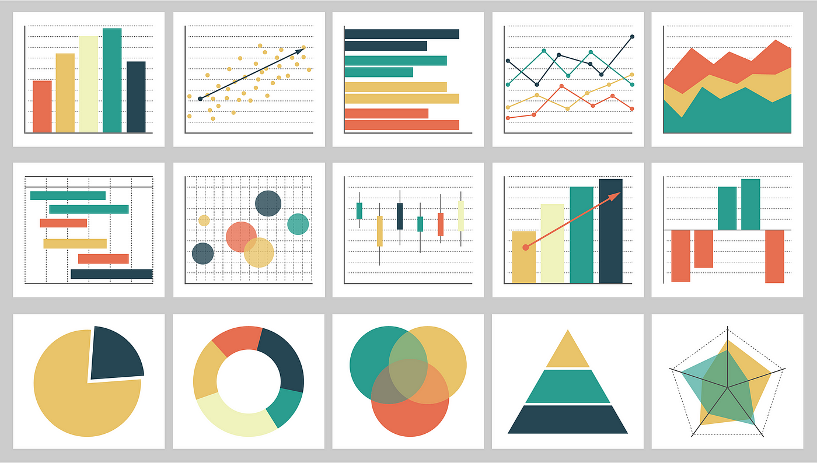
Matplotlib Introduction
Matplotlib is a powerful Python library used for creating static, animated, and interactive visualizations in Python. It provides a wide variety of plotting functions and customization options, making it a popular choice for data visualization tasks in fields such as data science, engineering, finance, and more.
Notes:
Simple and Intuitive: Matplotlib provides a simple interface for creating plots with just a few lines of code.
Wide Range of Plot Types: It supports various plot types, including line plots, scatter plots, bar charts, histograms, pie charts, and more.
Customization: Matplotlib allows extensive customization of plot appearance, including colors, markers, line styles, labels, titles, and axis limits.
Integration with NumPy: It seamlessly integrates with NumPy arrays, making it easy to plot mathematical functions and manipulate data.
Publication-Quality Graphics: Matplotlib produces high-quality, publication-ready graphics suitable for presentations, reports, and publications.

Slide 6
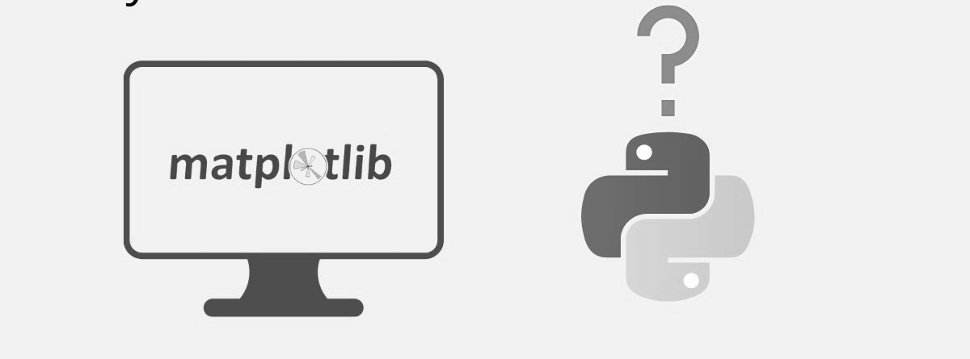
Why Matplotlib
Simple and Intuitive: Matplotlib provides a simple interface for creating plots with just a few lines of code.
Wide Range of Plot Types: It supports various plot types, including line plots (plot()), scatter plots (scatter()), bar charts (bar()), pie charts (pie()), and more.
Customization: Matplotlib allows extensive customization of plot appearance, including colors, markers, line styles, labels, titles, and axis limits.
Integration with NumPy: It seamlessly integrates with NumPy arrays, making it easy to plot mathematical functions and manipulate data.
Publication-Quality Graphics: Matplotlib produces high-quality, publication-ready graphics suitable for presentations, reports, and publications.

Slide 7
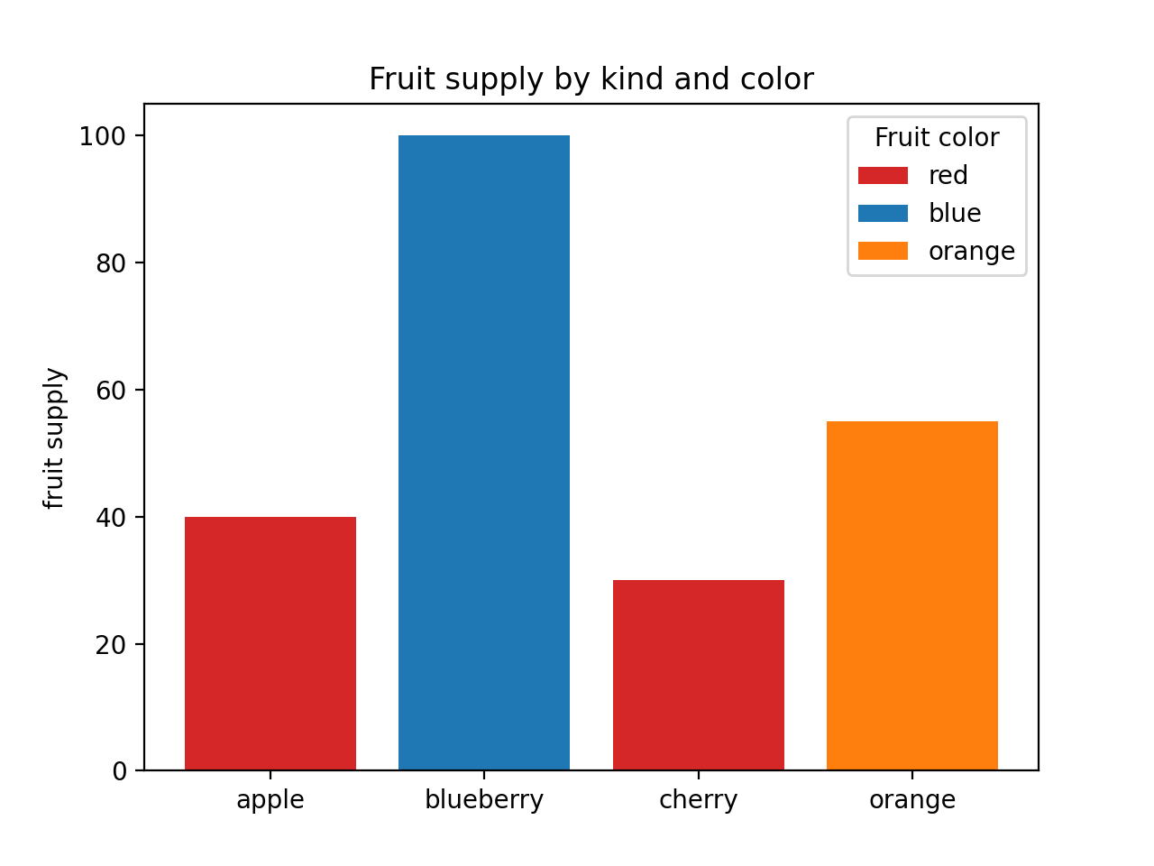
How to Use
A typical Matplotlib plot consists of several components:
Figure: The entire window or page that contains the plot. (plt.figure())
Axes: The area where data is plotted. A figure can have one or more axes. (plt.subplot(), plt.subplots())
Axis: The number line-like objects that define the boundaries of the data area. (plt.xlabel(), plt.ylabel(), plt.xticks(), plt.yticks())
Title: A descriptive title that explains the purpose of the plot. (plt.title())
Labels: Descriptive labels for the x-axis and y-axis.
Legend: An optional component that helps identify different data series. (plt.legend())
Grid: Optional gridlines that aid in reading the plot. (plt.grid())

Slide 8
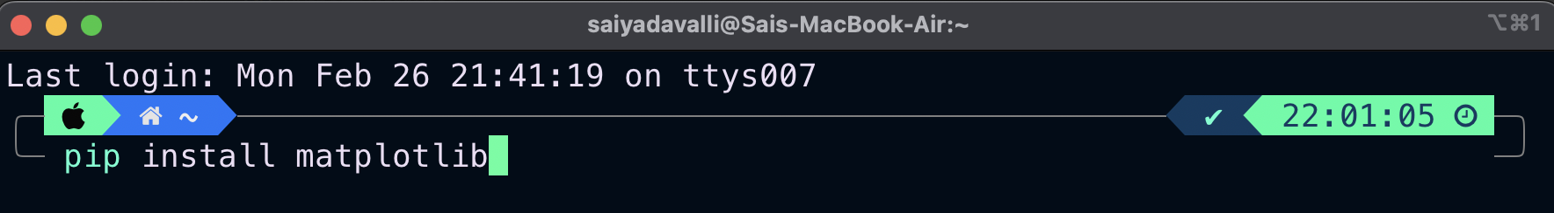
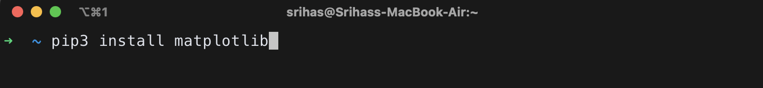
Getting Started
To get started with Matplotlib, you first need to install it using pip:
If that doesn’t seem to work try:

Slide 9
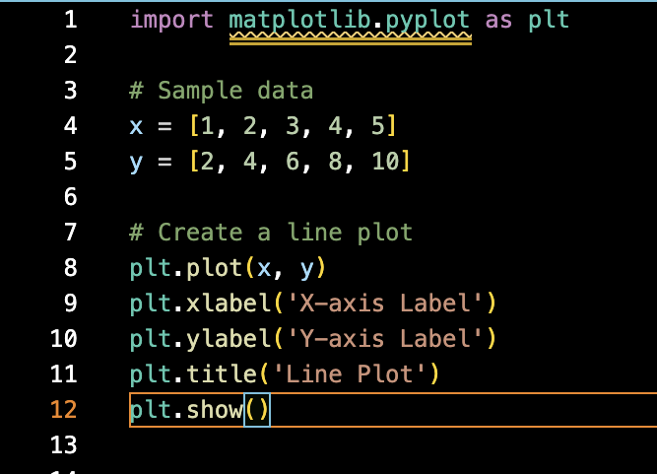
Basic Plotting Example

Slide 10
More on MatplotLib
Let’s practice more with the problem from last week…

Slide 11
Matplotlib Documentation
https://matplotlib.org/stable/index.html

Slide 12
Thank You!
Next class we will be covering a more advanced problem using matplotlib.

